Slide 1
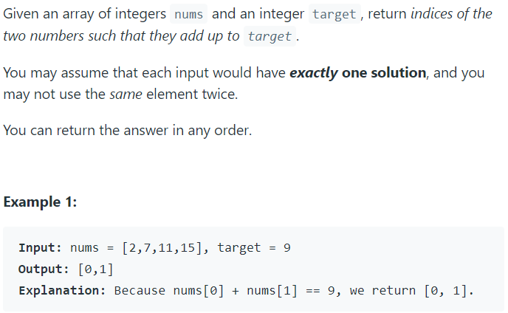
Day 1 of 100dayscodechallenge Platform - Leetcode Problem Statement:

Slide 2
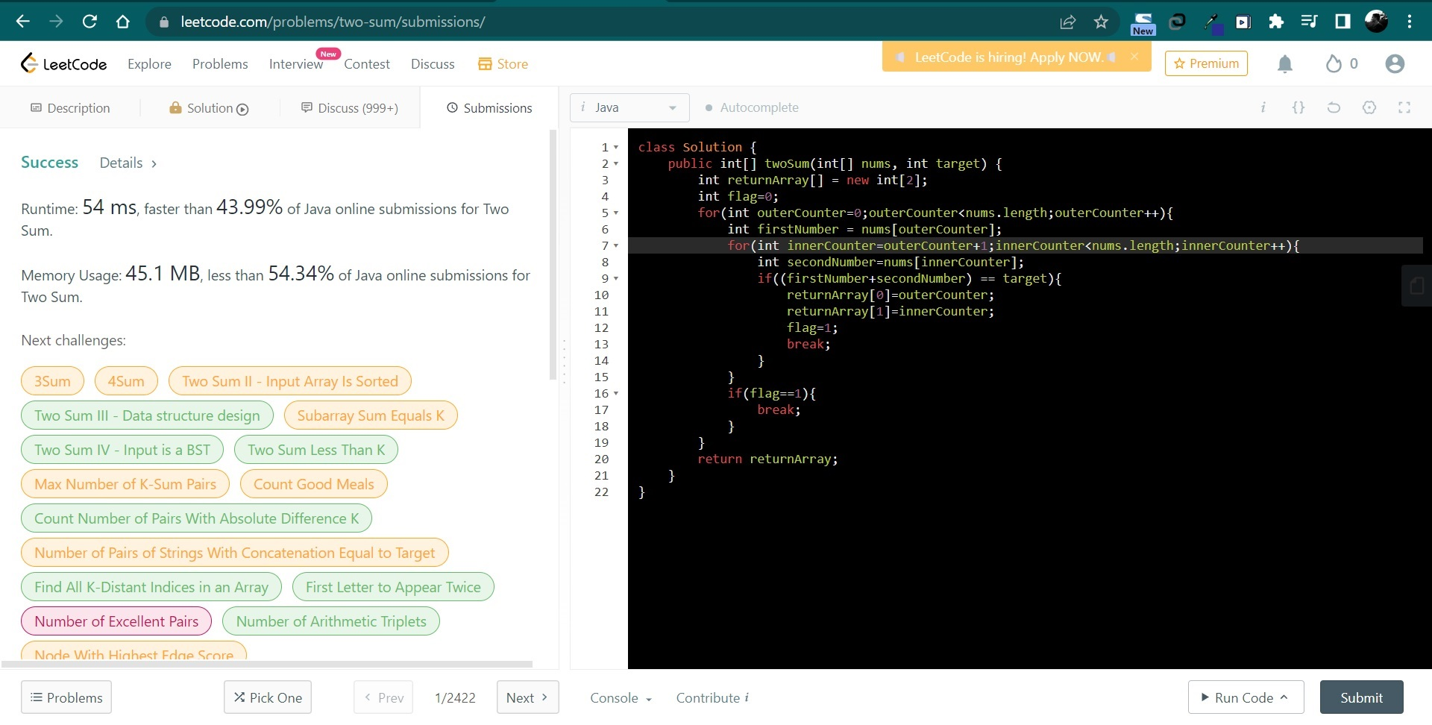
Solutions:

Slide 3
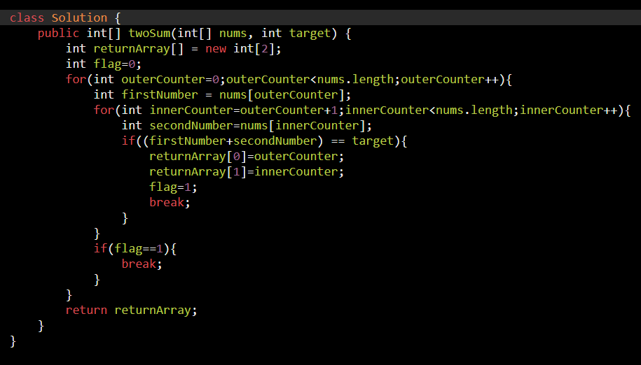
Explanation:
First of all I have initialized a return array which will store two values that is index of the array.
I have taken a variable FLAG which I have initialised as 0.
First for loop is running from 0th index to last index of an array.
When outer for loop is running, we are assigning array value in variable named as FIRSTNUMBER.
Next a nested loop is there which runs for outercounter+1 till last index of array.
Every time second loop is running we are assigning array value in variable named as SECONDNUMBER.
Now, every time we are checking if Sum of FIRSTNUMBER and SECONDNUMBER is equal to our target value.
If condition satisfies, we are setting FLAG as 1 and we are breaking from all loop and return the array.

